Slide 1


Password Management System

Slide 2

Enroll no. – 23002171310086
Batch – B11
Roll no. - 320

Slide 3
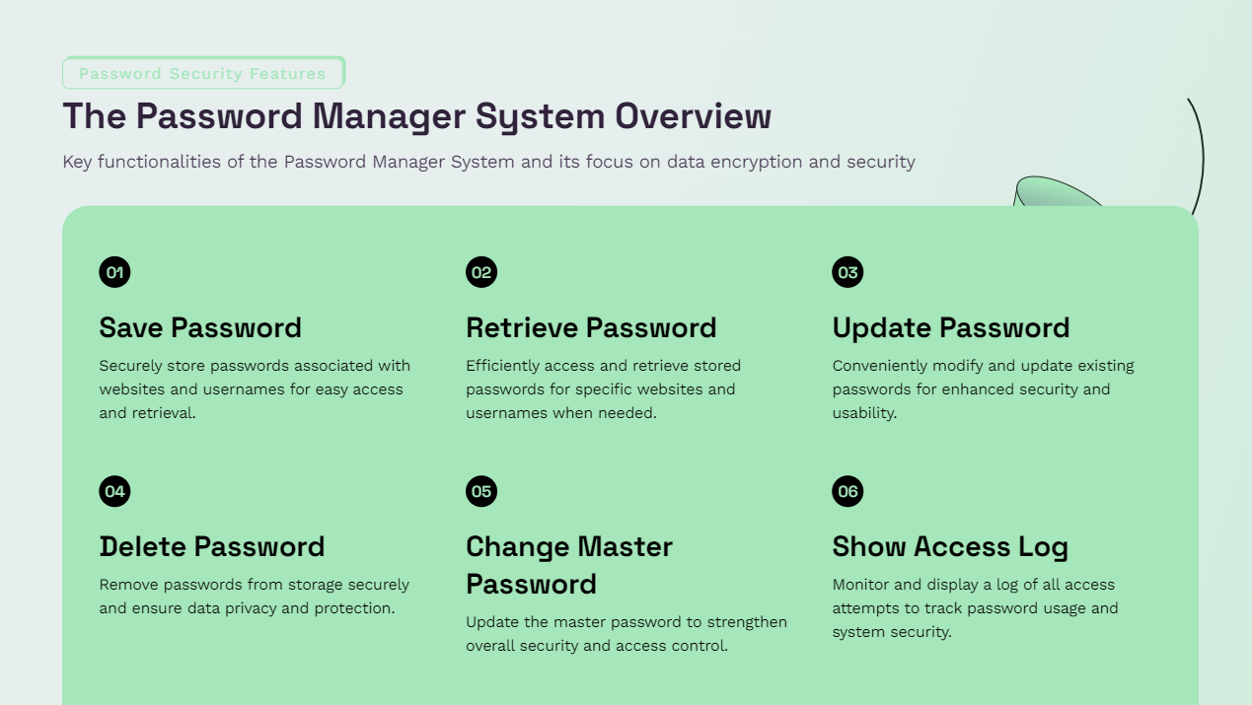

Slide 4
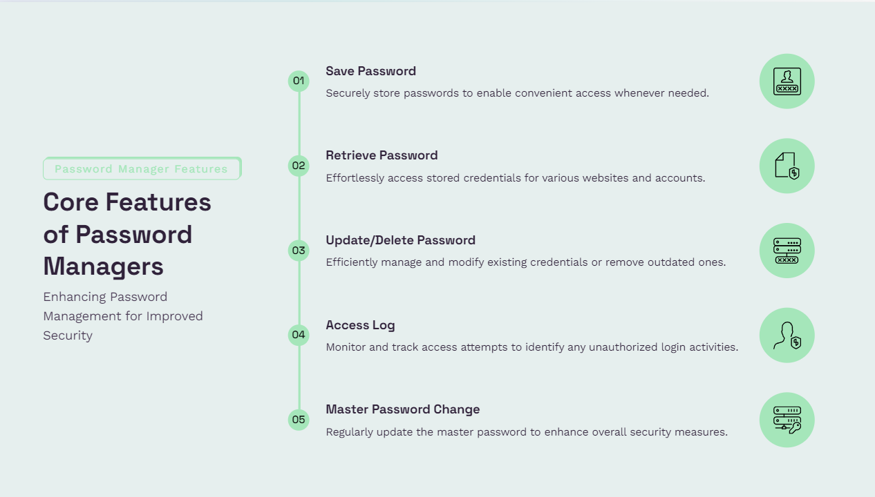

Slide 5
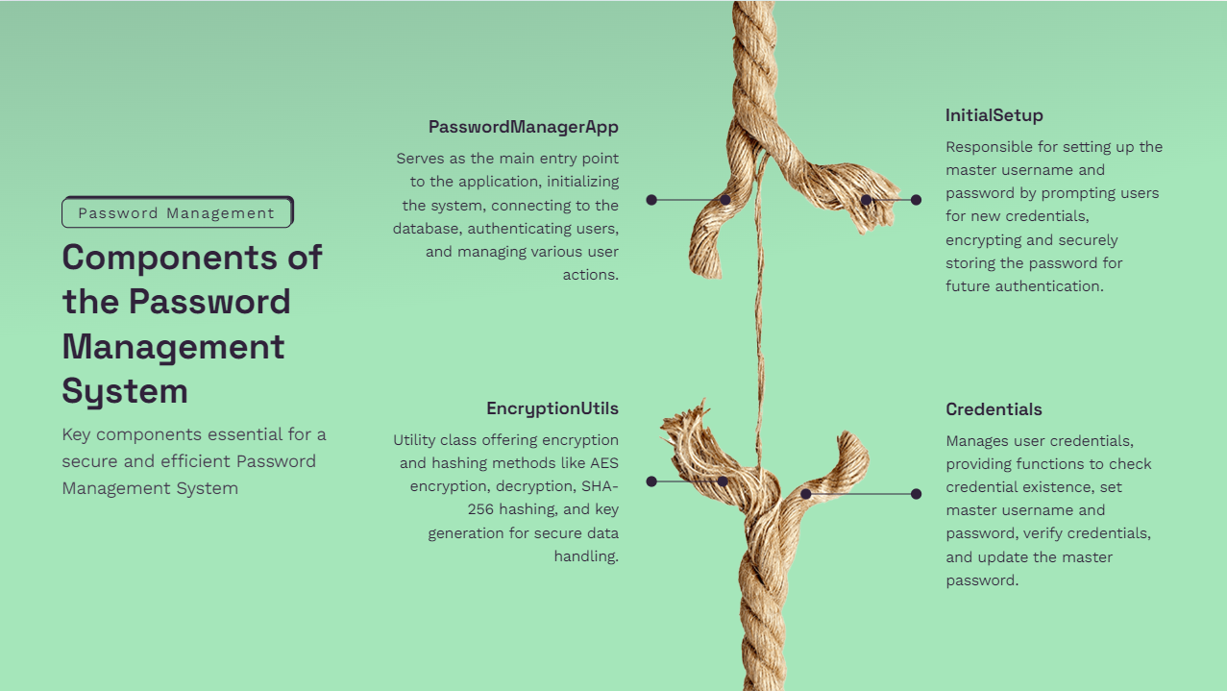

Slide 6
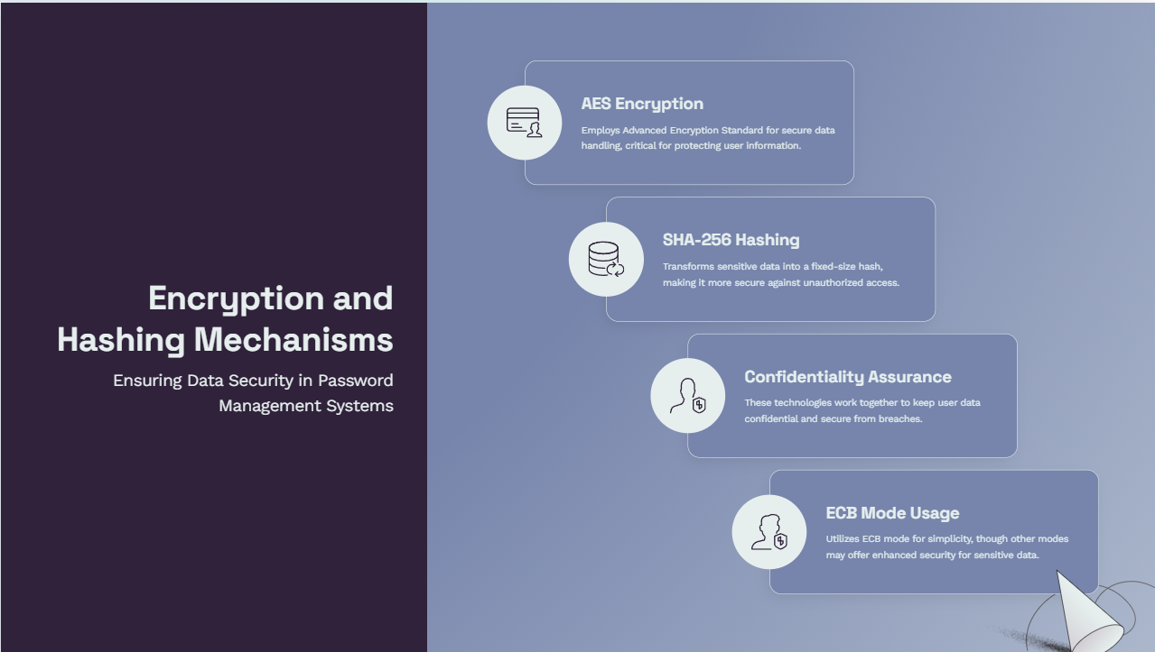

Slide 7


Slide 8


Slide 9
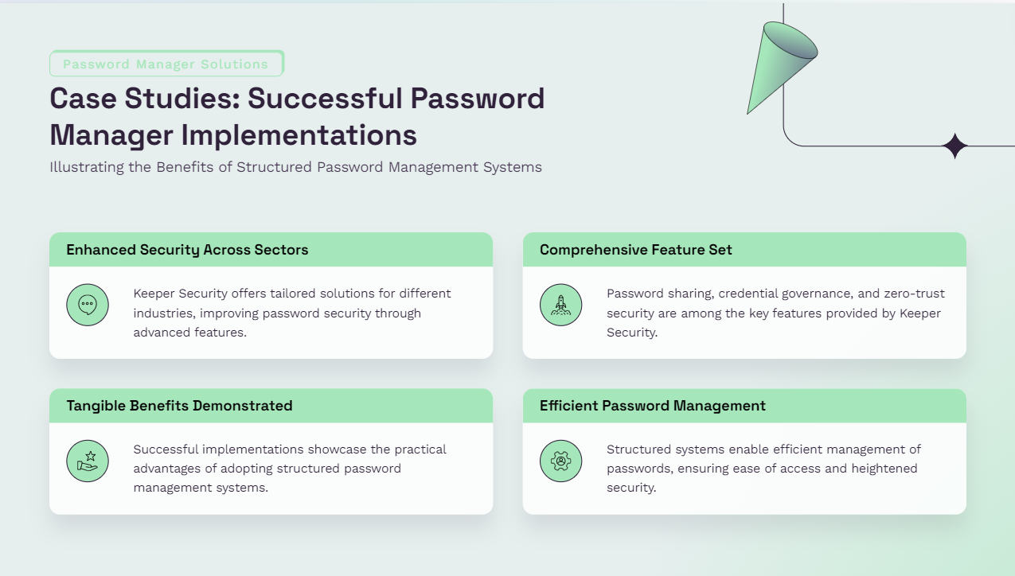

Slide 10
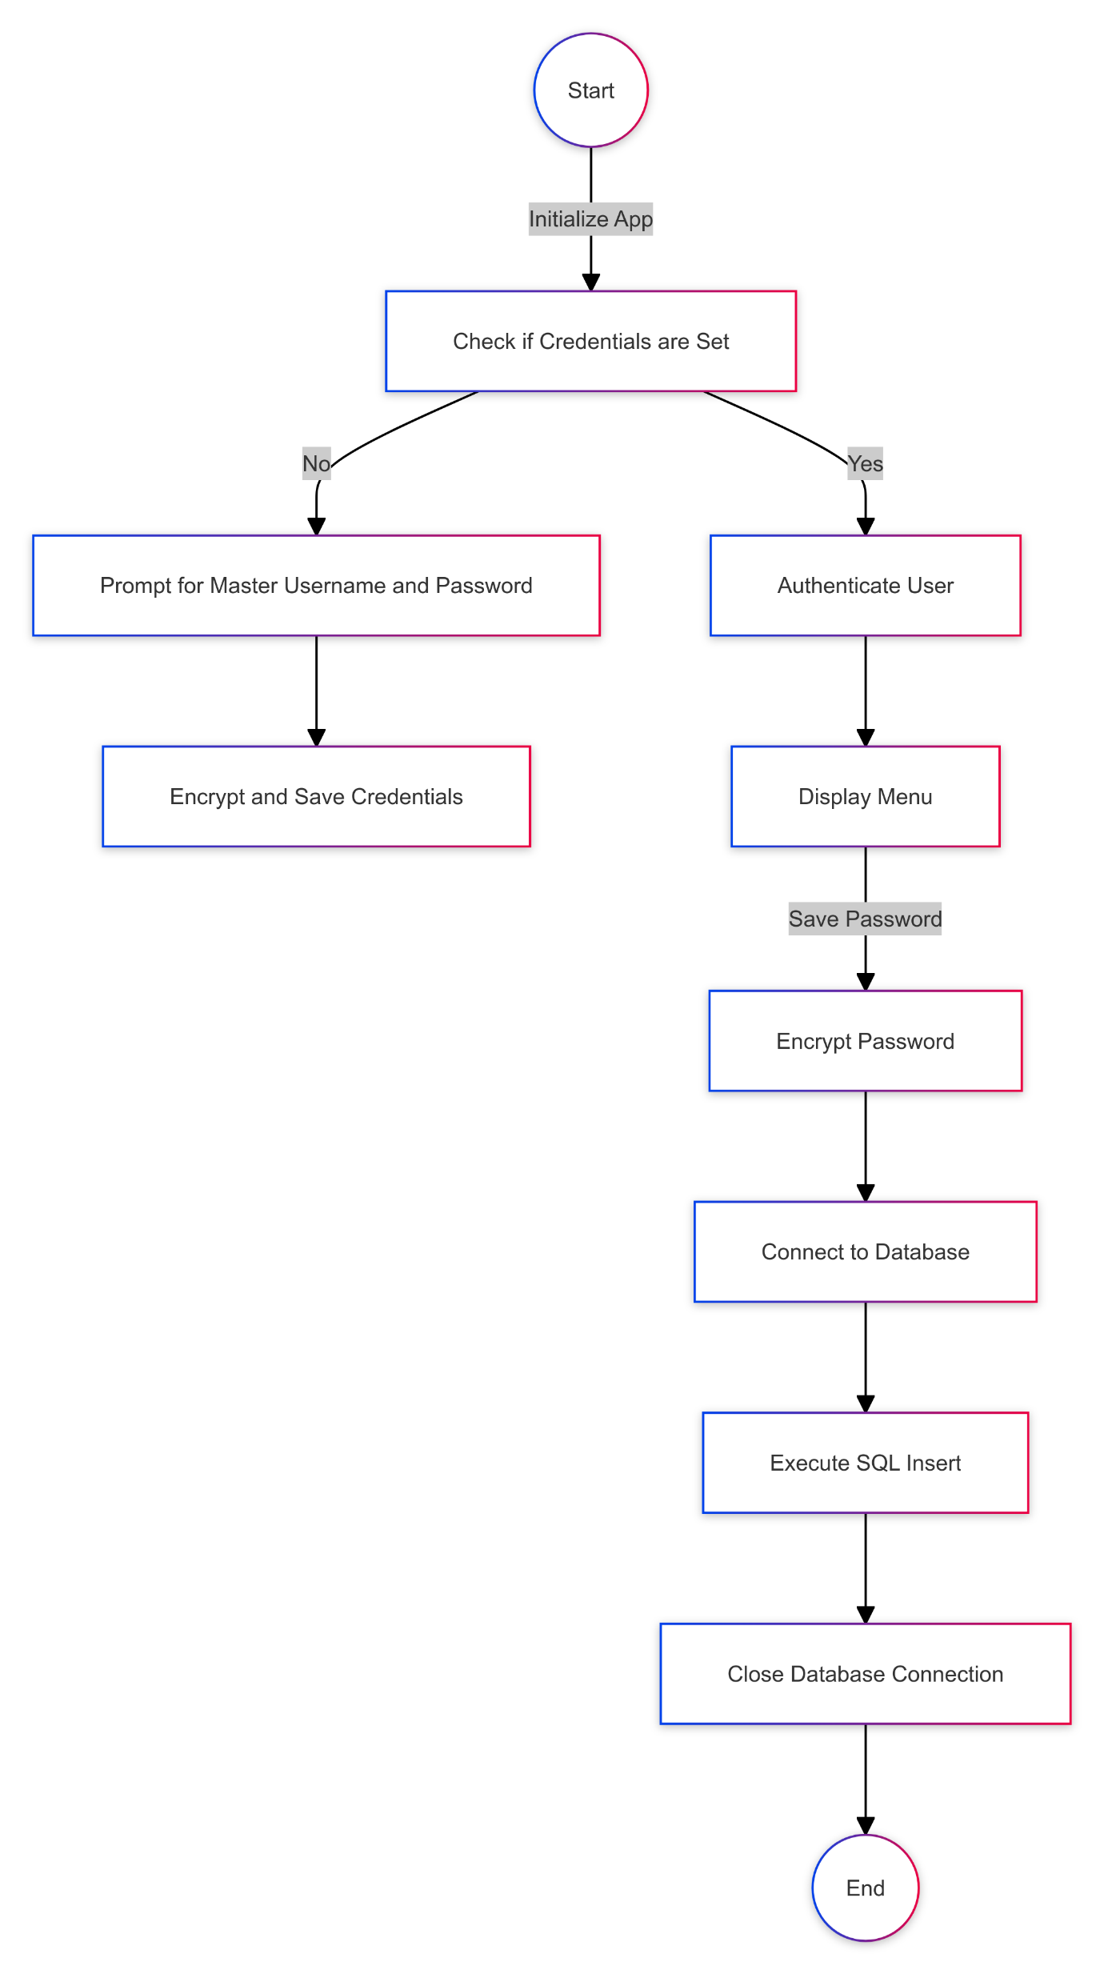
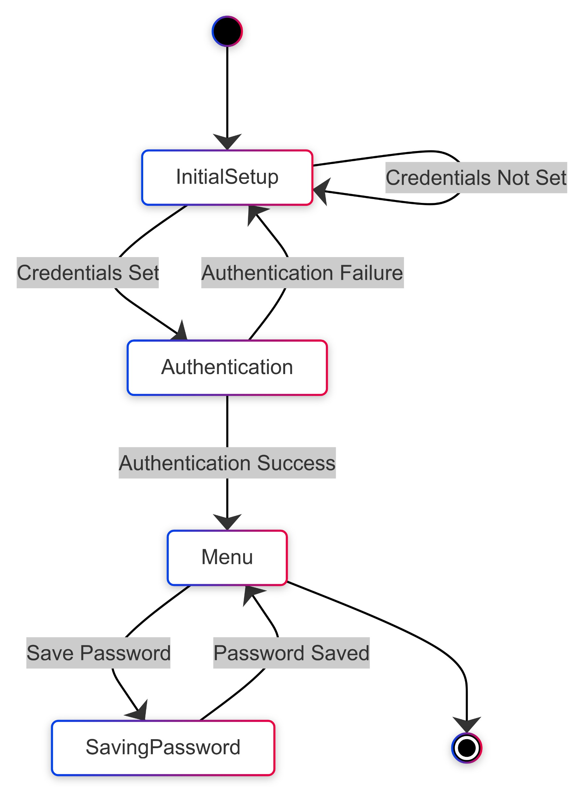
Software Diagrams
Image 2: The state diagram with steps for saving passwords and successful completion.
Image 1: Activity diagram outlining system setup and authentication.

Slide 11
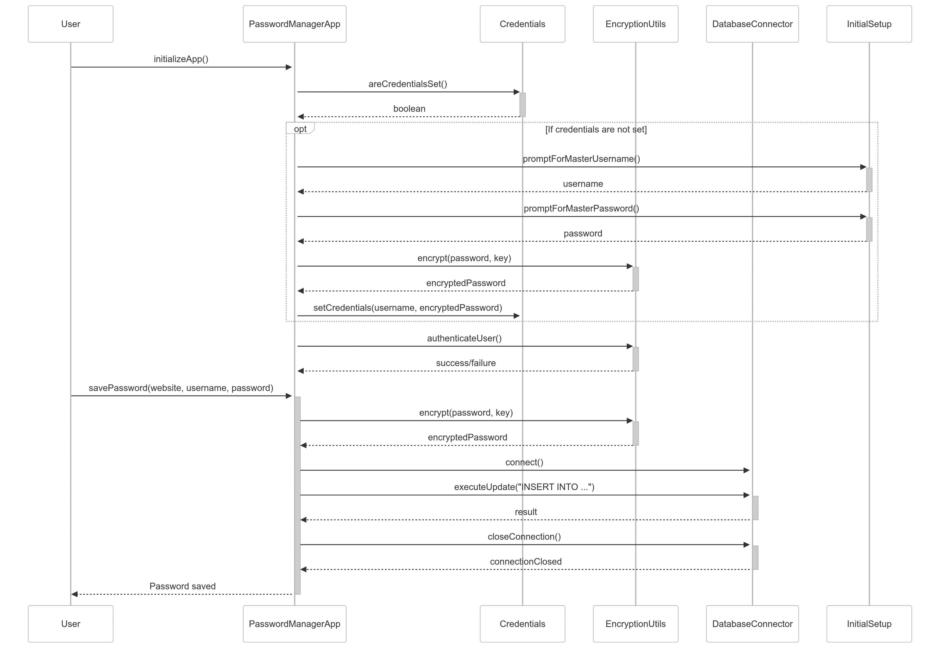
Software Diagrams
Sequence Diagram

Slide 12
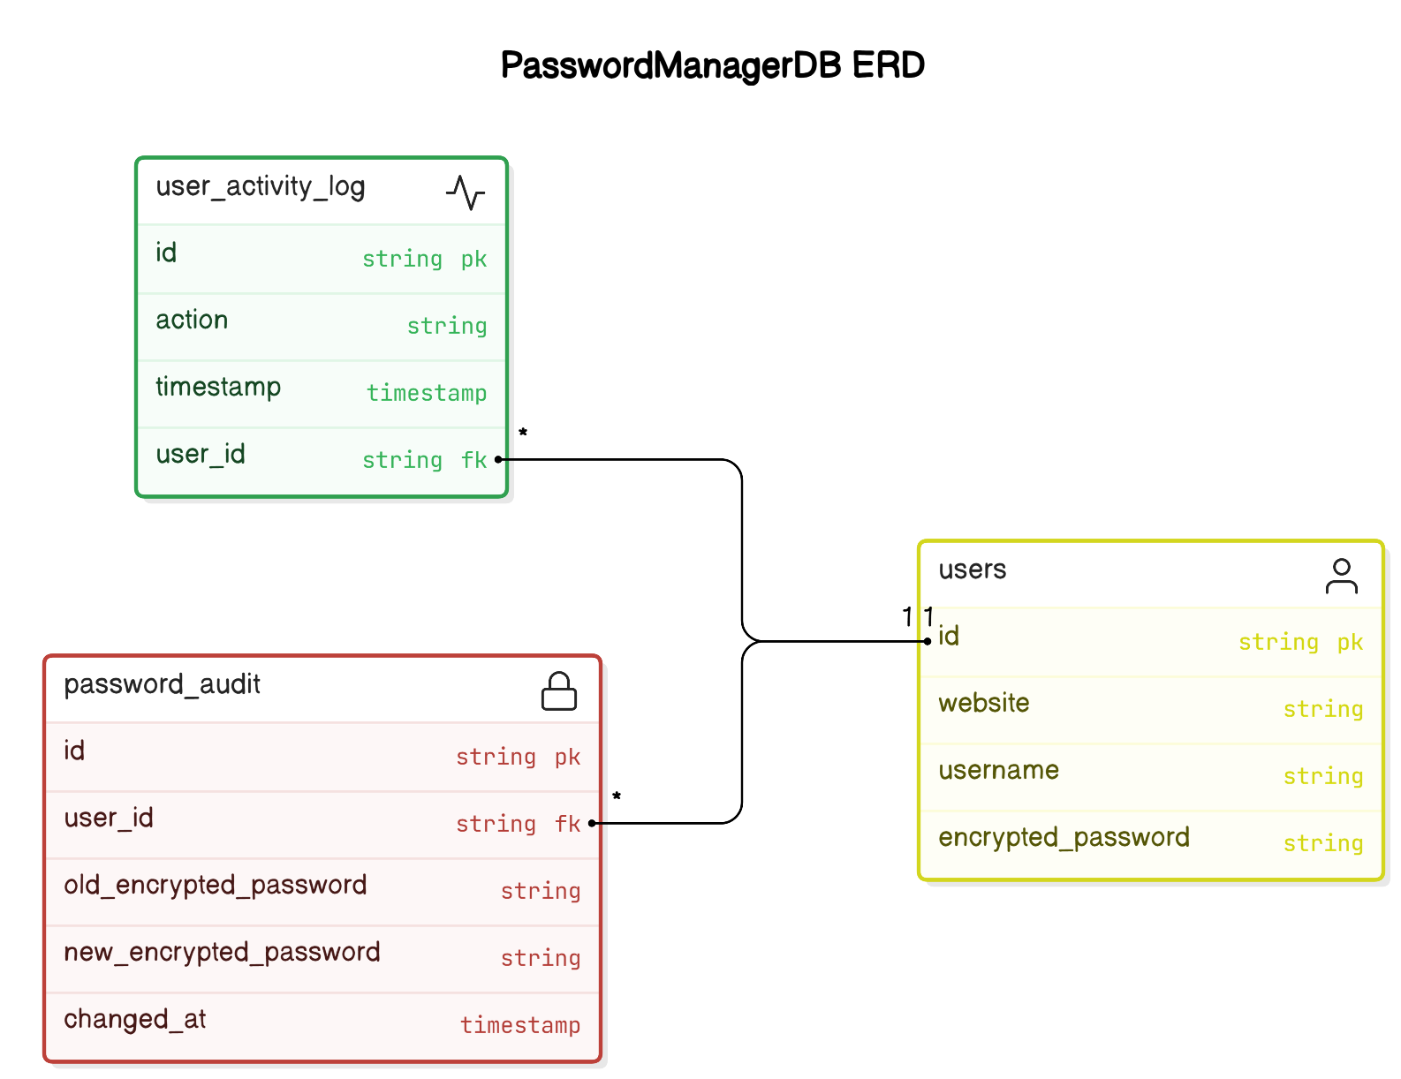
Software Diagrams
E-R Diagram

Slide 13
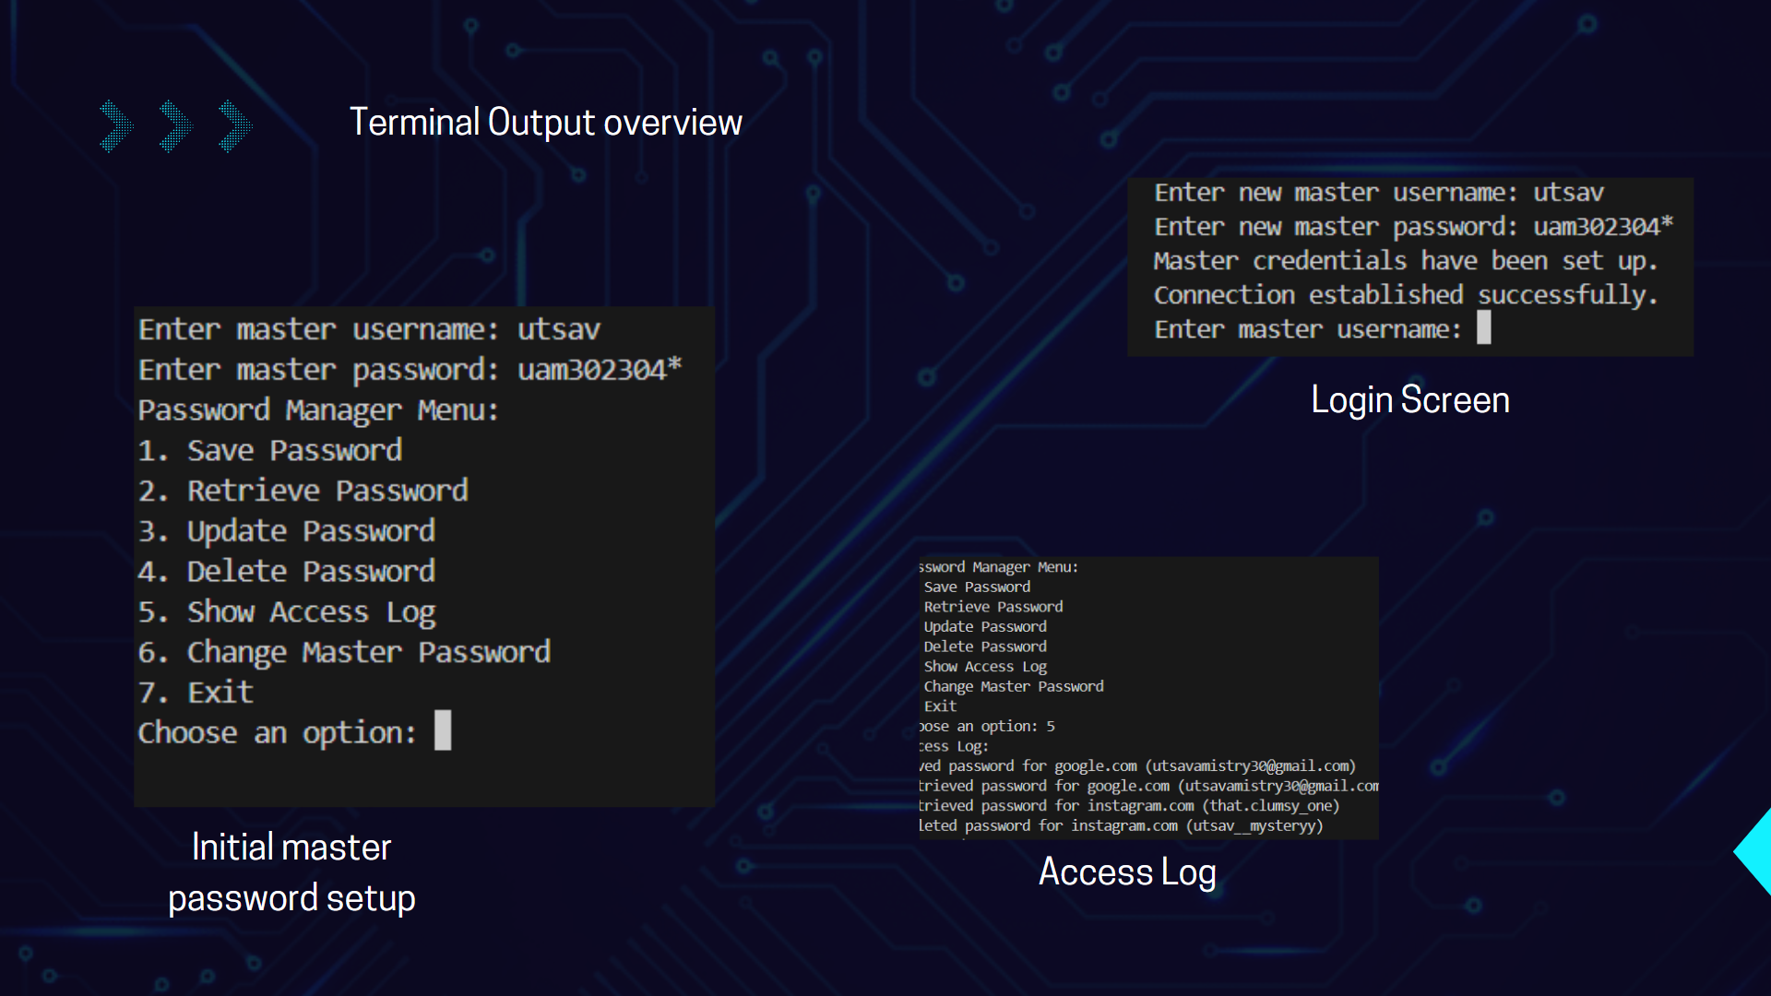

Slide 14



THANK YOU
Thank you for your attention. We hope this presentation has provided you with a clear understanding of the Password Manager System. If you have any questions or need further clarification, please don't hesitate to ask.

